Slide 1

VPH-Share Tutorial
Portal Login & Access
Data Semantics, Publishing & Query

Slide 2



VPH-Share Research Platform
VPH-Share is a 20-Partner FP7 Integrated Project that is constructing an online, cloud-based environment in which users can share software tools, applications and data, and can develop and execute in silico clinical workflows.
Four Flagship Workflows are included as demonstrators and, in recent months a significant number of additional Use Cases have been added to the project, several of which are already active
Operational for over 12 months, with new features and content being added continuously.

Slide 3




Platform Building Blocks
Unified Identity
Security
Workflows
Semantics
High Performance
Applications
Structured Data
Cloud Computing
Unstructured data

Slide 4


VPH-Share - Research Partnerships
Academic Partners
Industrial Partners
Clinical Partners
Third-Party Collaborators
Notes:
Slide Objectives:
Describe our current mix of partners and collaborators
Speaking Points:

Slide 5
Reviewers: Guided Introduction
At the project’s second periodic review in April 2013 the Reviewers proposed that, to obtain an enriched appreciation of the system, they might have access to the infrastructure during the two week period prior to the 3rd Periodic Review. This has been arranged, and VPH-Share accounts have been enabled for each reviewer.
VPH-Share, although carefully designed, is none-the-less a complex infrastructure and, as with all such systems, the full benefits emerge after a degree of familiarisation.
To help with this learning process we have prepared a set of illustrated guidance slide-sets that show users how to begin using the system and carry out three common activities.

Slide 6
For the busy reviewer
In all cases you’ll need to see through the Login process. The three activities are then described in separate tutorials, and each requires around 40 minutes to complete. If time doesn’t permit this degree of engagement, it may be that an agreement between Reviewers to split the three tasks amongst you may be a possible solution.
If this is palatable, the data-centred activities are probably the least challenging (perhaps 4/10), with the application and workflow development activities being the most challenging (perhaps 7/10)
If you’re particularly time-challenged, but would still like to try the system, the Data activity includes as its final step a search exercise to identify semantically-tagged data; this will give a flavour of the system without requiring a large investment of time.

Slide 7
VPH-Share Portal
Login & Access the VPH-Share Portal

Slide 8
Summary
To avoid the irritation that can arise from initial engagement with a new system, this first Login guide takes the user carefully through the Login process. In full, the process would be:
Locate the VPH-Share Portal https://portal.vph-share.eu/ (also easily found through Google)
Register on the VPH-Share site (already done for Reviewers)
Obtain an account on the central VPH authentication system Biomed Town (already done)
When notified of your account activation, revisit the portal and Login
Subscribe to any relevant group (Reviewers are already in the ‘Reviewers’ group)
(Note the online help and status information)
Only step 4 is strictly required for Reviewer access (though steps 5 and 6 are worth a look).

Slide 9
VPH-Share Portal
01
Google Search & Registration
04
Help & Documentation
02
Portal Login
05
Infrastructure Status & Monitoring
03
Groups & Membership

Slide 10

VPH-Share Portal – Registration

Slide 11

VPH-Share Portal - Login

Slide 12
VPH-Share Portal - Profile

Slide 13
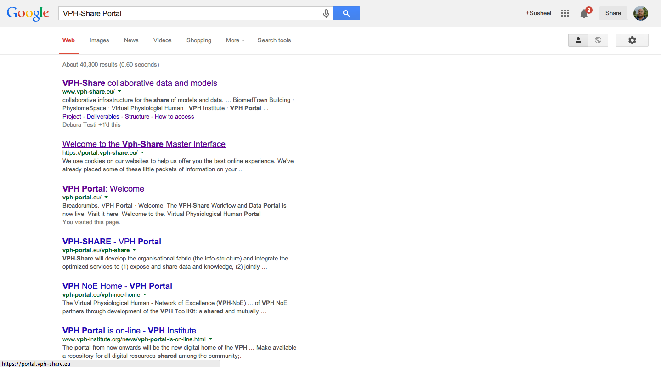
01
Google Search & Registration
Navigate to Google.com
Search for “VPH-Share Portal”
Click on “VPH-Share Master Interface”
b
c
VPH-Share is one of the top links on Google and can easily be searched and found within their index. The first link is usually the VPH-Share Portal.

Slide 14
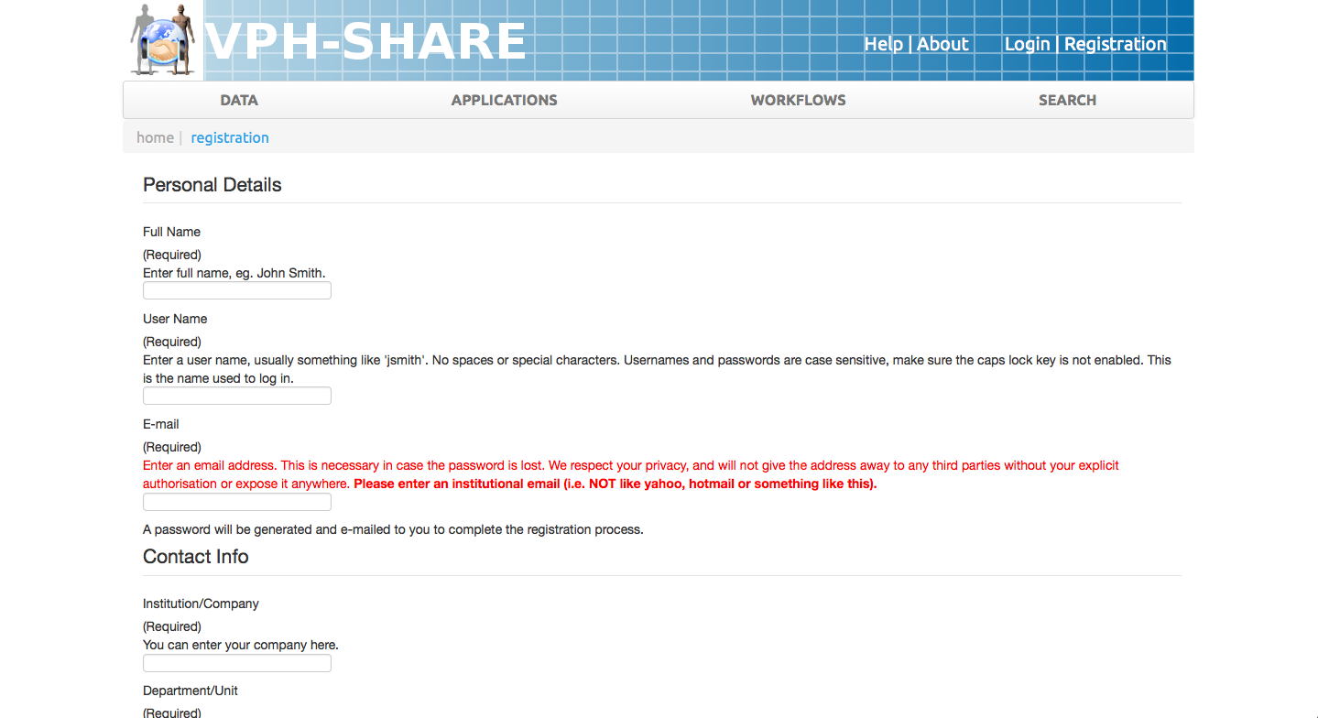
01
Google Search & Registration
Click on ‘Registration Link’
Complete Registration Form
Check email for password setting and complete registration
d
e
Registration is a simple process. We have tried to keep it as minimal as possible, in fact if you have a BiomedTown account, the process is even simpler.
Notes:
User Manual: http://www.vph-share.eu/content/registration-and-log
Video: https://www.youtube.com/watch?v=r480dPD3SeE + https://www.youtube.com/watch?v=il3HVFzjzSI

Slide 15
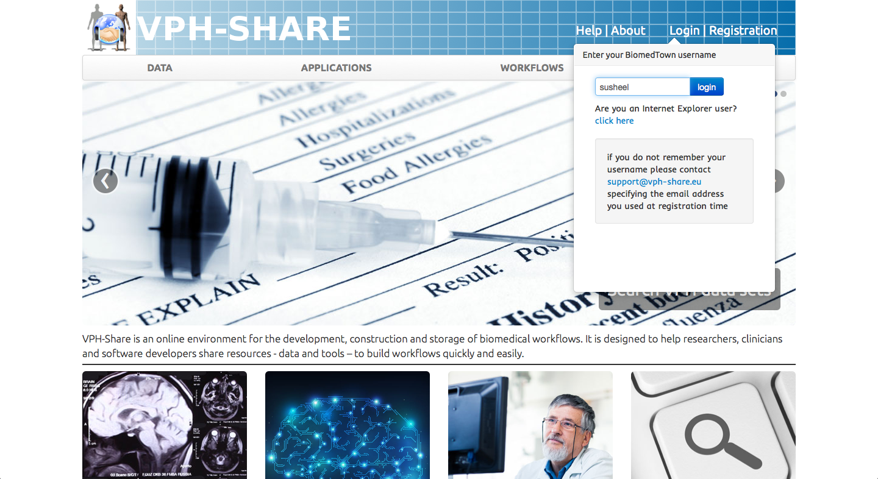
02
Portal Login
Click on ‘Login’ link
Submit ‘Username’ and then Submit ‘Password’
a
b
Login to the VPH-Share portal follow the OpenID protocol, which uses BiomedTown as our preferred identity provider. Your profile information is never transmitted without your permission.
Notes:
User Manual: http://www.vph-share.eu/content/registration-and-log
Video: https://www.youtube.com/watch?v=r480dPD3SeE + https://www.youtube.com/watch?v=il3HVFzjzSI

Slide 16
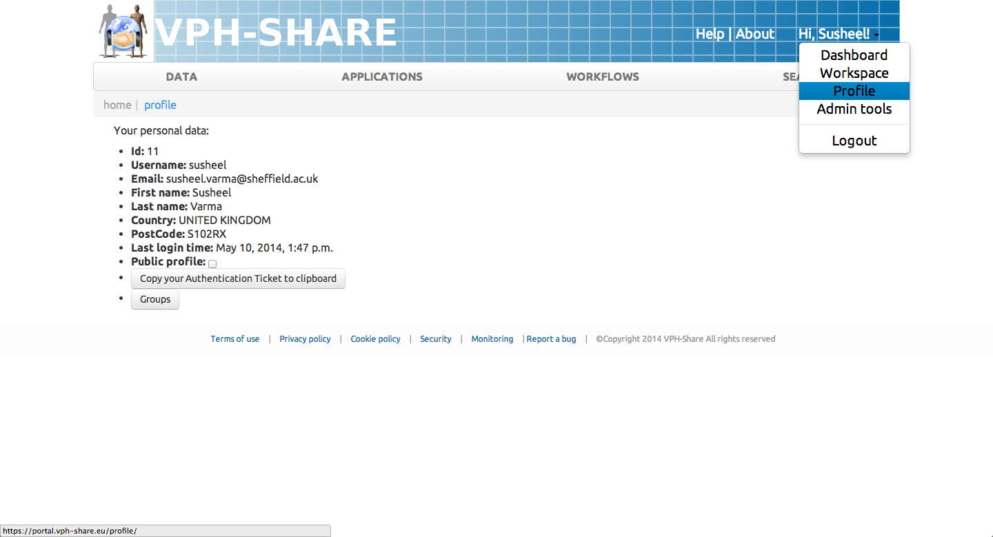
02
Portal Login
Click on ‘Login’ link
Submit ‘Username’ and then Submit ‘Password’
Click on your NAME and then ‘Profile’
Click on ‘Groups’
c
d
Login to the VPH-Share portal follow the OpenID protocol, which uses BiomedTown as our preferred identity provider. Your profile information is never transmitted without your permission.
Notes:
User Manual: http://www.vph-share.eu/content/your-profile

Slide 17
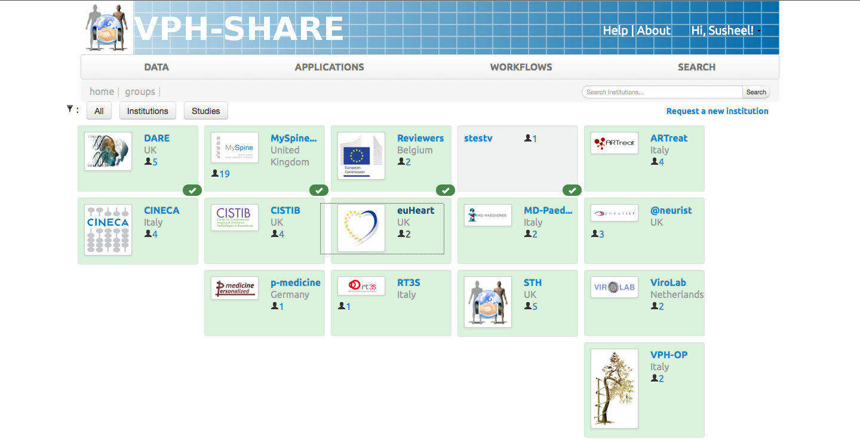
03
Groups & Memberships
Click on ‘Reviewers’ group
a
VPH-Share uses Groups and their user memberships as the primary mechanism to control role-based access to VPH-Share resources
Notes:
User Manual: http://www.vph-share.eu/content/institutions-and-studies

Slide 18
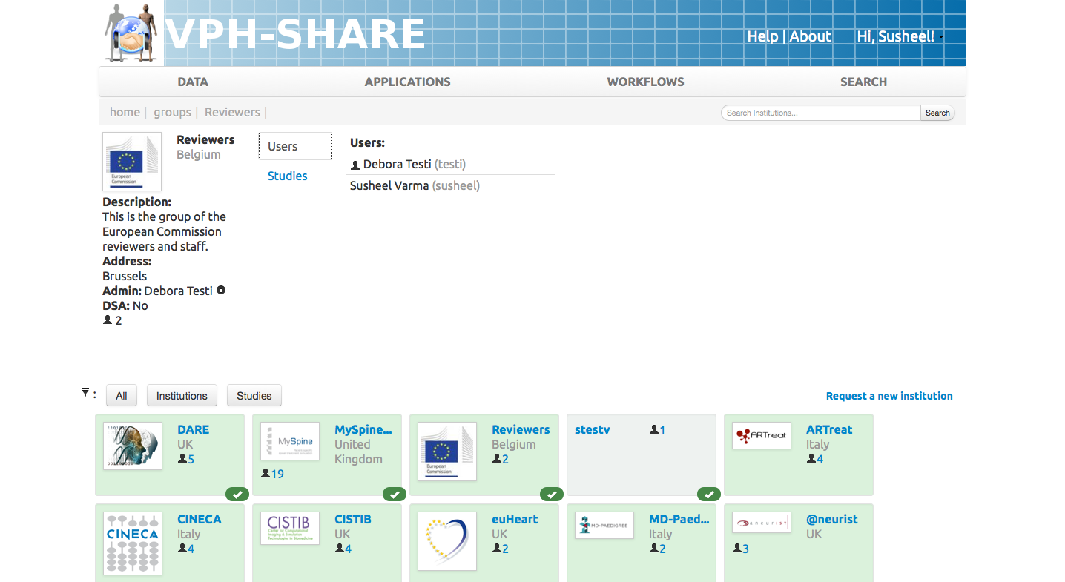
03
Groups & Memberships
Click on ‘Reviewers’ group
Check whether you are in the group, if not, Click ‘Subscribe’ which will be present.
VPH-Share uses Groups and their user memberships as the primary mechanism to control role-based access to VPH-Share resources
Notes:
User Manual: http://www.vph-share.eu/content/institutions-and-studies

Slide 19
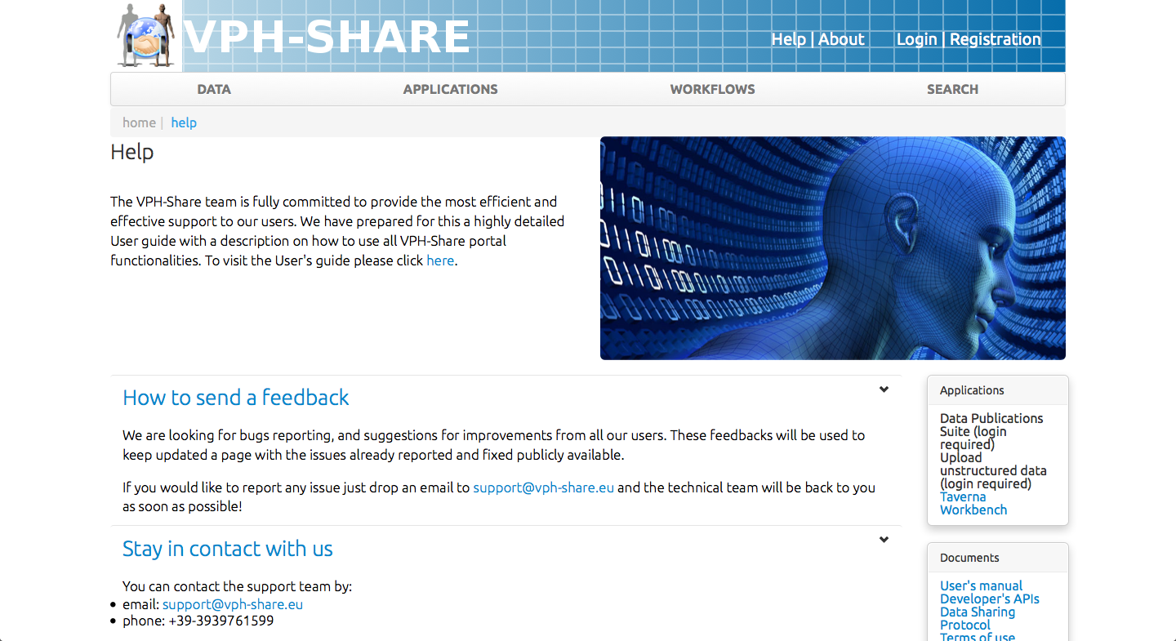
04
Help
& Documentation
Click on ‘Help’
If possible, peruse ‘User Manual’
Click and navigate the Developer API’s
Read the Data Sharing Protocol
a
b
VPH-Share have provided extensive documentation for end-users and developers and access to Terms & Conditions and Data Sharing Protocols
Notes:
User Manual: http://www.vph-share.eu/content/users-manual

Slide 20
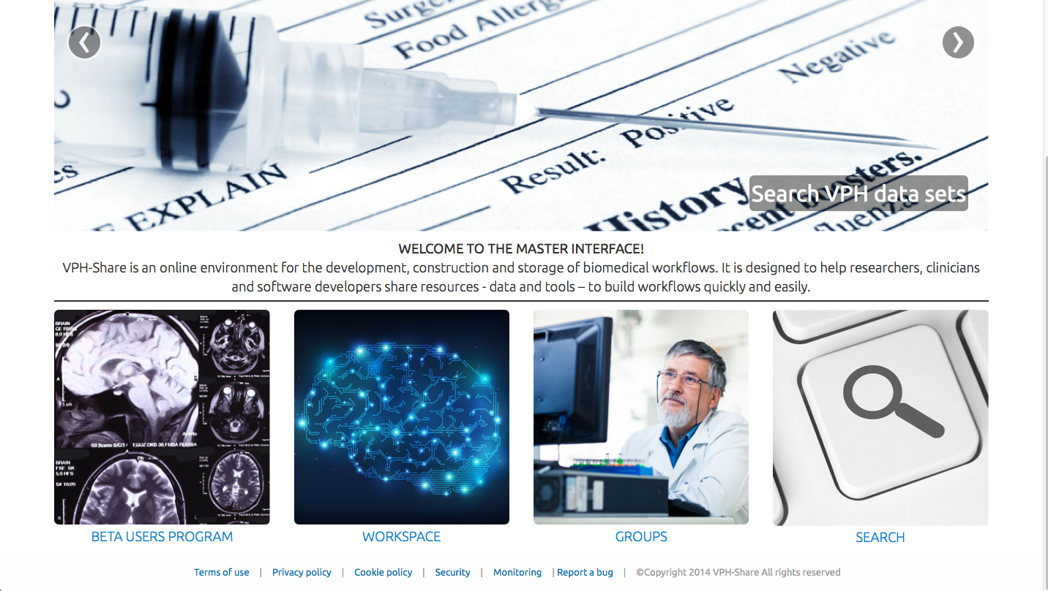
05
Infrastructure
Status & Monitoring
Click on ‘Monitoring’ link in footer
a
a
During Y3, VPH-Share has focussed on ensuring infrastructure services are available 24/7 and detailed monitoring and infrastructure status remains visible to the user.

Slide 21
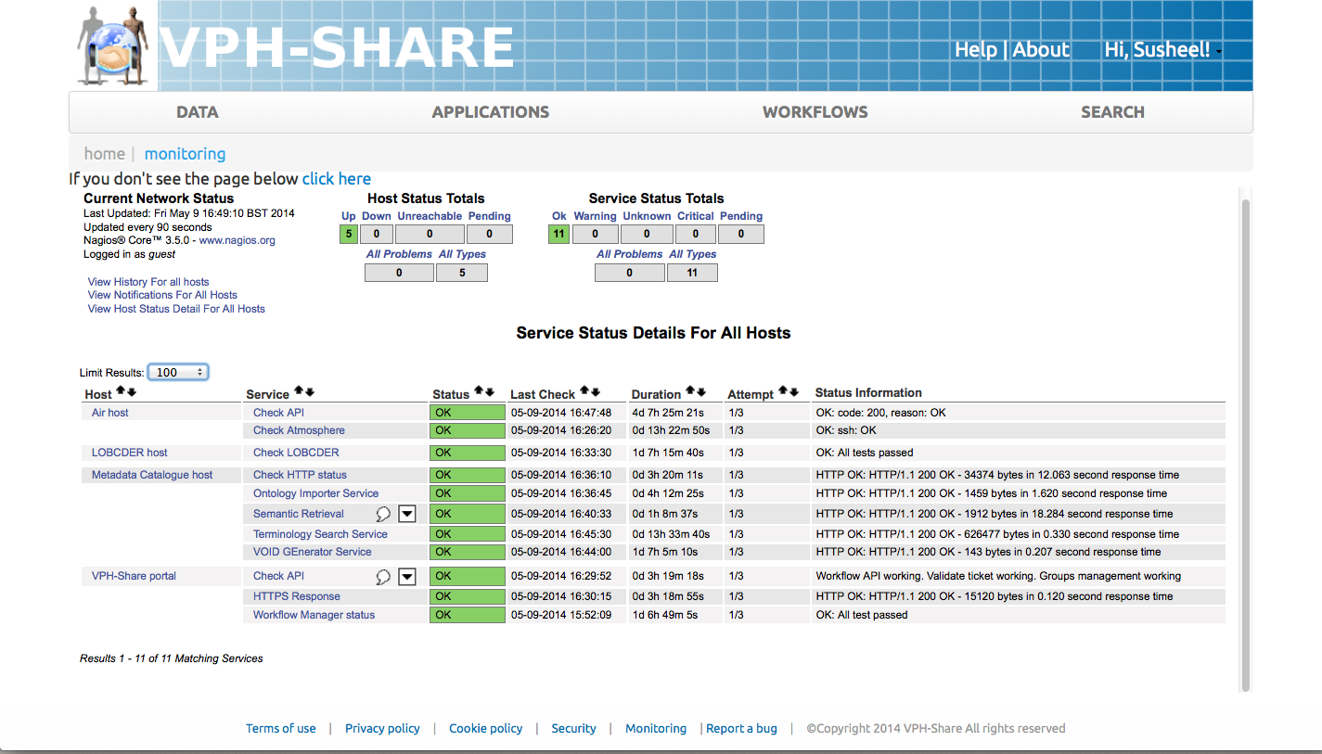
05
Infrastructure
Status & Monitoring
Click on ‘Monitoring’ link in footer
Status of the infrastructure is visible
Monitored service developers are notified on any issue 24/7
b
b
During Y3, VPH-Share has focussed on ensuring infrastructure services are available 24/7 and detailed monitoring and infrastructure status remains visible to the user.

Slide 22
GLOSSARY
API – Application Programming Interface
Dataset – A collection or related data
Delimited Data File – File format that stores data separated by a delimiter
Data Source – Local source data from which the data publication process can be performed
Data Destination – Destination to which data will be published
Ontology – Represents the hierarchy of concepts within domain
SHA1 Hash – A one-way encryption function to encrypt input
DICOM – An image formation frequently used in the medical domain
SPARQL – A query language that is used to extract knowledge from an RDF graph

Slide 23
Notes:
Slide Objectives:
Speaking Points:

Slide 24
Notes:
Slide Objectives:
Speaking Points:

